Slide 1
Course 9
Software process quality

Slide 2
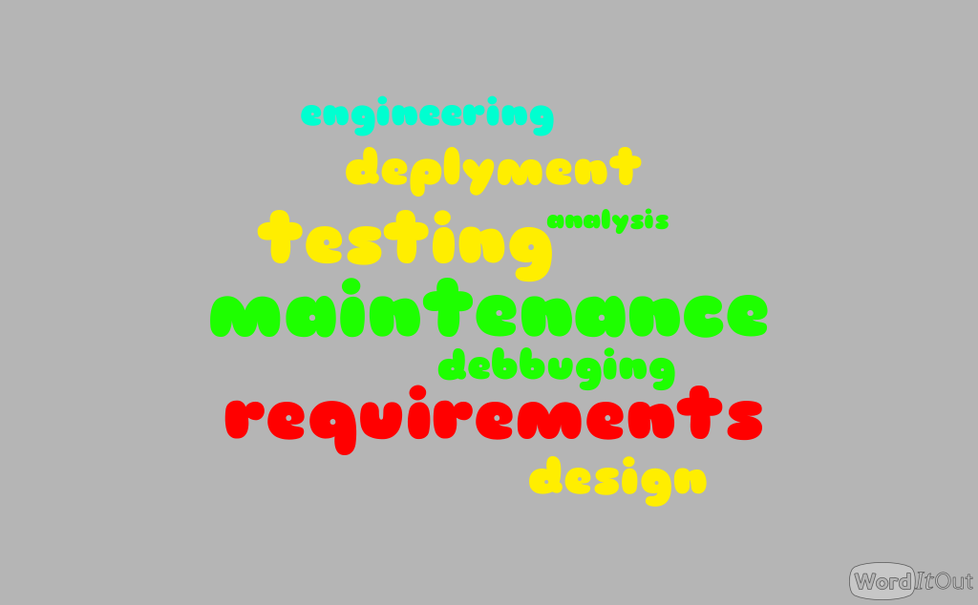
Software development processes
Software process = set of related activities that lead to the production of software

Slide 3
Software development methodologies
Spiral
Waterfall
Agile

Slide 4
Pro Cons
Estimation
Deliver
Control
Success = people + technology + manager
Introduce bureaucracy
Introduce extra costs
Only for large projects and companies
time
cost
quality

Slide 5
Achieve quality processes / improve processes
PDSA
CMM
ISO

Slide 6
ISO
WHY:
Software development and maintenance – highest quality
Better communication and understanding between:
Development & maintenance
Developers & external contributors
Providers & customers
Better management of complex projects

Slide 7
ISO 9000
ISO 9000: requirements a quality system must meet; addresses quality management and quality assurance standards. NOT how
ISO 9001: what quality standards should be followed. NOT how
ISO 9000:2000: serie - 8 key principles: Customer Focus, Leadership, Involvement of People, Process Approach, System Approach to Management, Continual improvement, Factual Approach to Decision Making and Mutually Beneficial Supplier Relationships

Slide 8
ISO 9000 documentation
Level 1: approach and responsibilities – Quality Manual
Level 2: who, what, when - Procedures
Level 3: how - Work / job instructions
Level 4: results – Records, documentation

Slide 9
ISO 9001: 2000 Structure
Quality Management System
Management Responsibility
Resource Management
Product Realization
Measurement, Analysis & Improvement

Slide 10
Procedure
Certification based
Valid 3 years
Requires a working system of Quality Management (regular internal audits, external audits)
Internal audit
Changes performed
Submit request
Formal audit by ISO

Slide 11
CMM

Slide 12
CMM (Capacity – Maturity - Model) CMMI (CMM Integration)
Developed by SEI (Software Engineering Institute) from Carnegie Mellon Univ.
Maturity = degree of formality to:
Define steps
Manage result metrics
Optimize processes

Slide 13
CMMI terms
Maturity levels – increased performance
KPA (Key Process Area): identify & group activities to achieve goals
Goals: scope + intend + range for each KPA
Indicates capability of org. for a maturity level
Common features: practices assoc. to a KPA
Key practices: implementation and adoption of KPA

Slide 14
Process Areas
Over 500 pages
Requirements Management
Organizational Process Definition
Project Planning
Organizational Training
Project Monitoring & Control
Integrated Project Management
Supplier Agreement Management
Risk Management
Measurement & Analysis
Integrated Teaming
Process & Product Quality Assurance
Integrated Supplier Management
Configuration Management
Decision Analysis & Resolution
Requirements Development
Organizational Environment for Integration
Technical Solution
Organizational Process Performance
Product Integration
Quantitative Project Management
Verification
Organizational Innovation & Deployment
Validation
Causal Analysis & Resolution
Organizational Process Focus

Slide 15
Maturity levels & KPAs
Level 1
Level 2
Level 3
Level 5
Level 4
Initial
Repeatable
Defined
Managed
Optimizing

Slide 16
CMM Maturity Level 1: Initial
No project management in place
Ad hoc practices
Activities are not preplanned – not pro-active, but reactive - respond to crisis
Unpredictable process
Cannot predict time and cost of development
Initiate project management

Slide 17
CMM Maturity Level 2: Repeatable
Basic SE management practices
Planning and management are based on experience (repeatable)
Track costs and schedules
Identify problems as arise and take immediate corrective action
Standardized process:
Peer review
Software product engineering: methods, technologies
Integrated software management
Organization-level: training, process definition

Slide 18
CMM Maturity Level 3: Defined
Process for development fully documented
Reviews used to achieve software quality
Introduce CASE Tools
• Software quality management
• Quantitative process management:
- Statistical process management: quantify quality and cost parameters
- Assess relative quality of each product

Slide 19
CMM Maturity Level 4: Managed
Organization sets quality and productivity goals for each project
Continous measurement
Statistical quality control in place
• Automatically collect process data
• use data to analyze and improve
• Defect prevention

Slide 20
CMM Maturity Level 5: Optimizing
Statistical quality and process control techniques
Process has positive feedback loop
To maintain level: Continue improvement and optimization of the process

Slide 21
2 representations of CMMI
Continous
Staged
Allows to select the order of changes
Predefined sets of PA to define improvement
Focuses on improvements within PA
Given sequence of improvements
Allows to select PA and improve it
Focuses on organization improvement

Slide 22
Capability Levels
Incomplete
Performed
Managed
Defined
Quantitatively Managed
Optimizing

Slide 23
Capability Levels
Initial
Managed
Defined
Optimizing
Quantitatively managed

Slide 24
PPQA (Process and product Quality Assurance)
Project management OR quality management
Quality Control
Quality Assurance
≠
Inspections
Structured walkthroughs
Different levels of testing
Process audit
Product audit
Evaluate:
Process to be followed
Quality control applied correctly
Quality control efficient & effective
≠
Testing
Project Quality Plan
Quality Assurance Plan

Slide 25
PPQA in CMMI
Is a Process Area (PA) - components
Required
Expected
Informative
What an organization must achieve to satisfy a process area
Specific + generic goals
what an organization may implement to achieve a required component
Specific + generic practices
how to approach the required and expected components

Slide 26
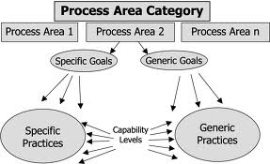
PPQA in CMMI
PPQA = PA
unique characteristics that must be present to satisfy a PA
characteristics that must be present to institutionalize the processes that implement a PA

Slide 27
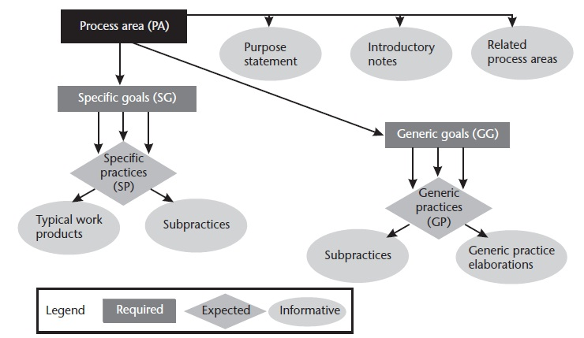
PPQA in CMMI

Slide 28
Specific goals & practices
SG1—Objectively Evaluate Processes and Work Products:
Objectively Evaluate Processes;
Objectively Evaluate Work Products and Services.
SG2—Provide Objective Insight:
Communicate and Ensure Resolution of Noncompliance Issues;
Establish Records.

Slide 29
SG 1: Objectively Evaluate Processes and Work Products
SP 1.1: Objectively Evaluate Processes
Sub 1.1.1: …
Sub 1.1.2: Establish and Maintain Clearly Stated Criteria for the Evaluations
SP 1.2: Objectively Evaluate Work Products and Services
…
Goal
Practice
Subpractice

Slide 30
Generic goals & practices
GG2: Institutionalized a Managed Process
GP 2.1: Establish an Organizational Policy
Goal
Practice
GP 2.2: Plan the Process
GP 2.3: Provide Resources
GP 2.4:Assign Responsibility

Slide 31
CMMI Appraisal
Awarded a maturity level rating: 1-5
3 classes: A, B, C
Standard CMMI Appraisal Method for Process Improvement (SCAMPI)

Slide 32
Success stories
Boeing’s Space Transportation Systems Software
Tata Consultancy Services (TCS)
Thales ATM
CMMI level 5:
Romania 0
Germany 0
France 1
UK 3
A substantial shift in defect detection, from 89% late detection by testing to 83% early detection by application of various review methods.
Earlier detection of defects caused a 31% decrease of rework efforts.
Elimination of defects prior to version release increased from 94% to almost 100%.
A 140% increase in general productivity.
According to official site – CMMI Appraisal Results:
https://sas.sei.cmu.edu/pars/pars.aspx

Slide 33
Quality management maturity grid [P. Crosby – Quality is free]
Measurem. Categ. | Stage I Uncertainty | Stage II Awakening | Stage III Enlightenment | Stage IV Wisdom | Stage V Certainty
Manag. Underst. & attitude
Quality org. status
Problem handling
Costs of quality as % of sales | 20 | 18 | 12 | 8 | 2.5
Q. improv. actions
Company quality pos.
We don’t know why we have problems with quality
We know why we don’t have problems with quality

Slide 34
ISO – CMM Differences
ISO9001:2000 | CMMI-DEV
International standard, applies to all types of organizations, supports both product and service oriented organizations | Written specifically for software development companies
A brief document – about 25 pages long, identifying the minimal requirements for a quality system | A detailed document – over 500 pages long
Emphasizes on a management of continuous improvement process, based on the PDCA (Plan-Do-Check-Act) model | Emphasizes on achieving “maturity” and improving its process continuously
One level of standard. The standard is based on recommendation | Defines 5 maturity levels of the organization, covering 25 process areas (PAs)
Netta Dotan, Quality Assurance & project management, Ronkal Office Technologies

Slide 35
ISO – CMM Differences
ISO 9000 | SW-CMMI
Outwardly focused | Inwardly focused
Minimum requirements with implied continuous improvements | Explicit continuous quality improvement
Registration Document | No documentation
Certification audit for a 50 employee organization will be executed by 1 -12 auditors during one day | Certification audit for a 50 employee organization will be executed by 4 auditors during 4-5 days
Netta Dotan, Quality Assurance & project management, Ronkal Office Technologies

Slide 36
PDSA

Slide 37
PDSA = Plan – Do – Study - Act
Former
PDCA = Plan – Do – Check – Act / Adjust

Slide 38
A little bit of history (R.Moen, C. Norman - Evolution of the PDCA Cycle)
W.A. ShewHart – father of statisctical quality control
W.E. Deming– father of modern quality control
Notes:
PDCA (plan–do–check–act or plan–do–check–adjust) is an iterative four-step management method used in business for the control and continuous improvement of processes and products.^{[1]}It is also known as the Deming circle/cycle/wheel, the Shewhart cycle, the control circle/cycle, or plan–do–study–act (PDSA)
- Consider the main motor to Japan economy revival

Slide 39
Plan
Do
Study
Act
Iterative
Separation of phases

Slide 40
Objectives
Questions and predictions
Plan to carry out
Plan

Slide 41
Carry out plan
Document problems and unexpected observations
Gather data
Begin analysis of data
Do

Slide 42
Complete analysis of data
Compare data to the predictions
Summarize conclusions
How: gap analysis, appraisals
Study

Slide 43
Find root of issues
Re-evaluate risk
Determine changes to de made
Implement changes in order to prepare next iteration
Act

Slide 44
Conclusions:
PDCA + 7 basic tools (see course 8) = foundation for improvement (kaizen) in Japan (‘50)
Toyota: „Building people before building cars”

Slide 45
Who need / use SQA?
Provides visibility into the effectiveness and efficiency of the processes being used and the resulting product quality
SQA
Developers
Management
Software Engineers
Provides feedback to the individual projects on the efficiency and effectiveness of the processes that they are following so they can be improved at the project level
Provides feedback to the SE group on the organizational processes they have facilitated
in developing so they can be improved at the organizational level

